Slide 1
Dependency injection in Razor Pages

Slide 2
Class coupling (why it’s bad)
One class depending on another
Cannot exist (compile) without other class
Limits functionality to single implementation
Example : If classes perform DB work, difficult to test without hitting Data Access code

Slide 3
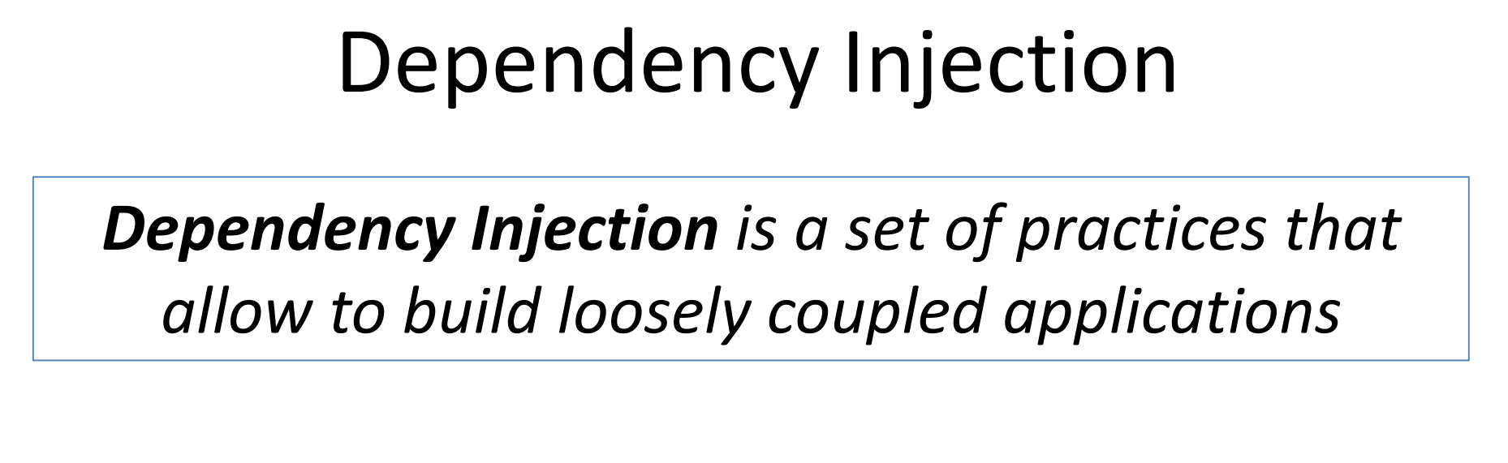

Slide 4
Dependency Injection
Dependency Injection (DI) is an architectural pattern that promotes loose coupling of software through separation of concerns.
In the context of a Razor Pages application, DI encourages you to develop discrete components for specific tasks, which are then injected into classes that need to use their functionality.
Dependency injection results in an application that is easier to maintain and test.

Slide 5
Advantages of Dependency Injection
Typically implemented with the aid of an object DI container
Advantages :
Allows us to write decoupled code
Facilitate testability and extendibility.
Ease deployment of components

Slide 6
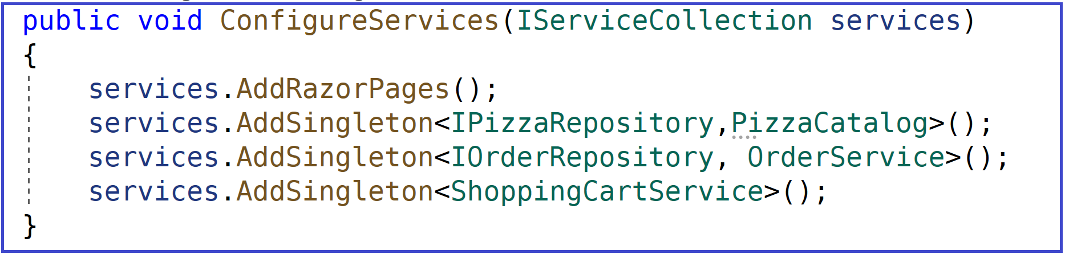
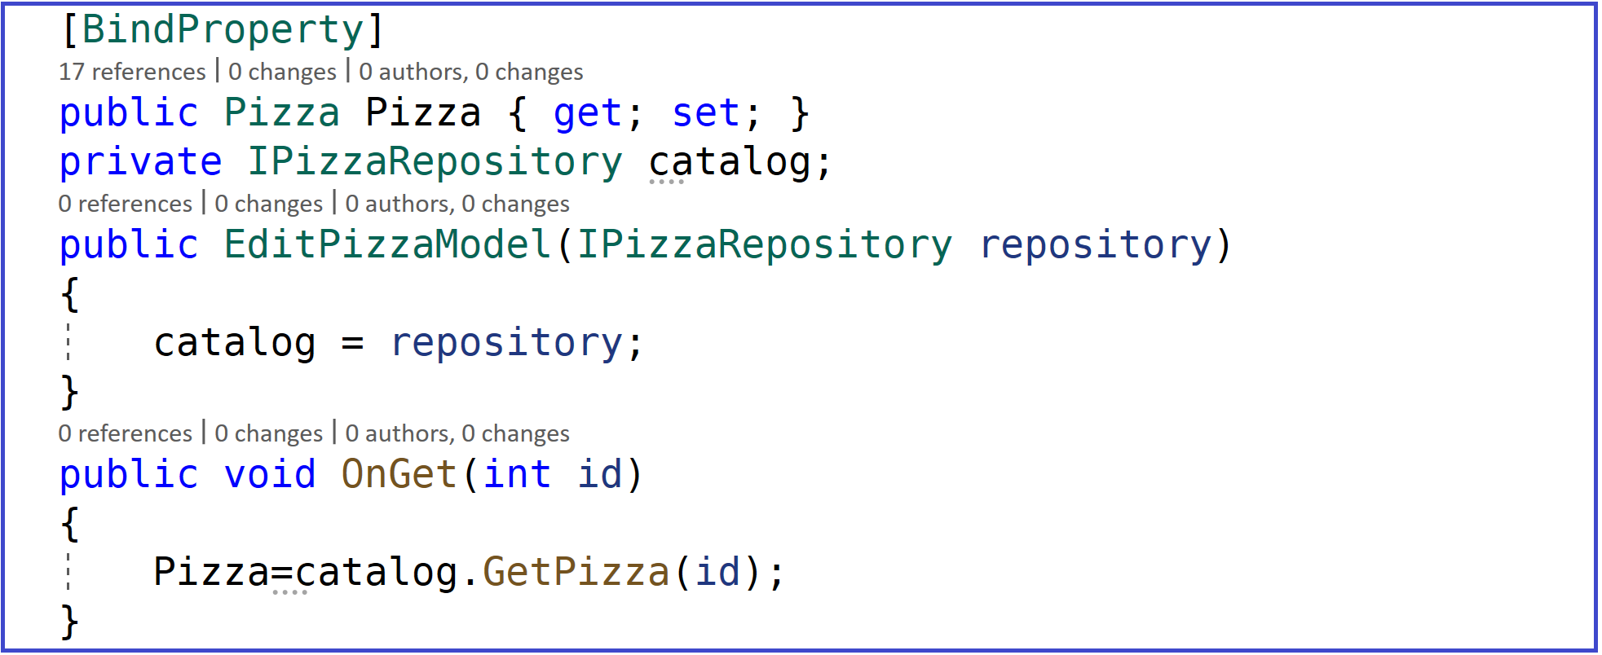
Dependency Injection in Razor Pages Application
Registering Services
Injecting Services ( in the contructor of the page)

Slide 7
Lifetime and registration options
Three different lifetimes
Depending on how the lifetime of an operation's service is configured, the DI container provides either the same or different instances of the service when requested by a class:
Transient ( use AddTranscient method)
Transient lifetime services are created each time they're requested. This lifetime works best for lightweight, stateless services.
Scoped ( use AddScopped method)
Scoped lifetime services are created once per http request.
Singleton ( use AddSingleton method)
Singleton lifetime services are created the first time they're requested.
Every subsequent request uses the same instance.

Slide 8
ASP.NET Core DI - Lifetime
AddTransient
Transient lifetime services are created each time they're requested. This lifetime works best for lightweight, stateless services.
AddScoped
Scoped lifetime services are created once per http request.
AddSingleton
Singleton lifetime services are created the first time they're requested.
Every subsequent request uses the same instance.

Slide 9
Conclusion
Dependency Injection (DI) is an architectural pattern that promotes :
Low coupling - Easy to refactor and reuse classes
Plug-In architecture - Easy to replace or extend functionality
Late Binding - Implementation can be swapped at runtime, typically based on configuration
Transparency – Explicit dependencies makes it clearer what each component does
Easier maintenance : No need to change existing code and re-test it.
Testability – Easy to isolate dependencies and create mocks
Work in Parallel – contracts enable simultaneous development of interacting components (no need to wait for dependencies to be finished)

